Slide 1
Wildflower Florist LLC
Mikayla Hawley, Austin Bing-Zaremba, Jordan Moser, Tyler DeChellis, Savanna Pulver

Slide 2
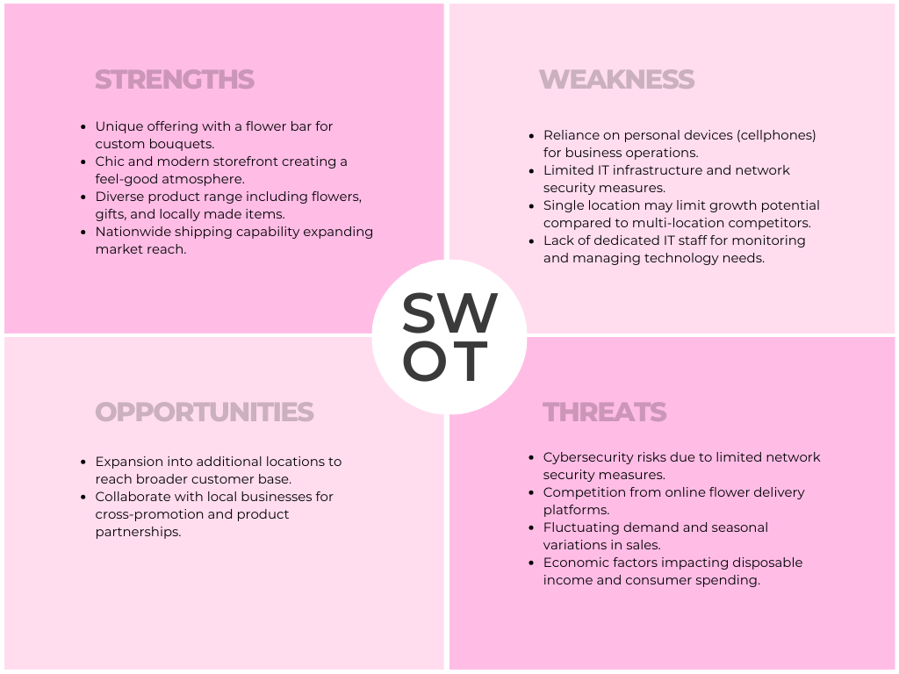
SWOT

Slide 3

Needs Assessment
The main concern is network security
She does not have as large of a budget that larger companies have
Notes:
After meeting with Jessica, we found that the main concern is network security. With being a small business, she does not have the budget that other companies have to spend on improving network security

Slide 4
Need #1 Secure Wi-Fi Information
Statement of Purpose | To ensure sensitive customer information regarding customer orders is secure, Wildflower Florist needs to protect sensitive information such as their WiFi password.
Situation / Goals | Currently Wildflower Florist keeps their WiFi information taped to a wall by the bathroom. This creates a security risk as customers ask to use the bathroom in the back.
Process | Jessica will take down the WiFi information on the wall by the bathroom and keep their information in a secure spot only employees will know about.

Slide 5
Need #2 Two-Factor Authentication
Statement Of Purpose | A two-factor authentication will help secure the iPad at the shop that holds important information in it. Instilling a two-factor system such as Face ID and receiving text messages within a code to log in or receiving in through email will help secure the devices limiting potential hazards like a password being leaked and giving access to the iPad from a 3rd party device.
Situation/Goals | The two-factor system being installed will limit the number of potential hackers trying to get into the system due to their being a required code.
Process | When an employee is logging into an iPad, after they input the correct password exclusively correlated to their account. They will receive a one-time code to their personal phone number or email that they will then put in the iPad to confirm the login.

Slide 6
Threats
Data Breach
Network Vulnerabilities
Physical Security
Notes:
- Data Breach: the risk of unauthorized access to customer, business, and personal information as well as financial records
- Network Vulnerabilities: Weakness in the networks infrastructure expose Wildflower Florist to the risk of malware infections, data theft, or disruption of services
- Physical Security: The physical security of devices and equipment, including laptops, iPads, and the printer, is crucial. Theft, damage, or unauthorized access to these assets could disrupt business operations and compromise sensitive information

Slide 7
Threats Continued
Third-Party Risks
Employee Training
Regulatory Compliance
Notes:
- Third-Party Risks: Dependencies on third-party services, such as Metronet for internet connectivity or Google Sheets for data storage, introduce risks related to service outages, data breaches, or compliance issues
- Employee Training: Insufficient training or awareness among employees regarding cybersecurity best practices increases the risk of human error, social engineering attacks, and inadvertent data breaches
- Regulatory Compliance: Failure to comply with relevant regulations, such as data protection laws or payment card industry standards, may lead to legal penalties, financial losses, and damage to company’s reputation

Slide 8
Risk Analysis
Likelihood: The likelihood of a data breach or network compromise is moderate to high given the prevalence of cyber threats targeting small businesses. Physical security risks are relatively lower but still significant
Impact: The impact of a data breach or network intrusion could be severe, resulting in financial losses, reputational damage, legal consequences, and disruption of business operations. Physical security incidents may lead to equipment downtime and productivity losses
Risk Rating: Based on the likelihood and impact, the overall risk rating for data breaches and network vulnerabilities is considered high, while physical security risks are moderate

Slide 9

Risk Strategies
Implement Robust Security Measures
Enhance Access Controls
Physical Security Measures
Notes:
-Implement Robust Security Measures: Deploy firewalls, antivirus software, and intrusion detection systems to protect against cyber threats. Regularly update and patch software to address vulnerabilities
- Enhance Access Controls: Implement strong password policies, multi-factor authentication, and least privilege access to limit unauthorized access to systems and data
- Physical Security Measures: Secure devices and equipment with locks, surveillance cameras, and access control systems. Store sensitive information in locked cabinets or safes

Slide 10
Risk Strategies Continued
Vendor Risk Management
Employee Training
Compliance Management
Notes:
- Vendor Risk Management: Assess the security practices of third-party vendors and ensure compliance with data protection regulations. Maintain backups of critical data stored with third-party providers
- Employee Training: Provide regular cybersecurity awareness training to employees to educate them about common threats, phishing scams, and best practices safeguarding data
- Compliance Management: Establish processes and controls to ensure compliance with relevant regulations, including data protections and privacy laws. Conduct regular audits to assess compliance posture

Slide 11
Risk Conclusion
By conducting a thorough risk assessment and implementing appropriate mitigation strategies, Wildflower Florist LLC can actively mitigate potential threats and vulnerabilities to its IT infrastructure and operations. Proactive risk management is essential for safeguarding sensitive information, maintaining business continuity, and preserving the trust of customers and stakeholders

Slide 12
Disaster Recovery & Security Plan
Critical System | Threat | Response Strategy | Response Action Steps | Recovery Strategy | Recovery Action Steps
Confidential Data | Security threat to information | Make sure important information is highly secured using the previously implemented two factor auth | Make sure important data is always password protected | Immediately disconnect the compromised device or devices from the network. Disable remote access to the network if possible, to prevent further unauthorized access. | Analyse what has been compromised and asses from there
Outdated Technology | Out of date systems | Buy up to date technology if the latter can no longer hold the information needed securely. | Purchase new technology | Identify the specific technology needs based on current requirements and future growth projections. | Figure out what technology needs to be updated and purchase the up-to-date software or version

Slide 13
Gap Analysis
Password and Information Security | Partially met | All technology owned by the company has been given a unique password as well as each employee assigned a unique and complex username. Two-Factor authentication is still being implemented into Wildflower's technology.
Secure Wi-Fi Password | MET | Complex Wi-Fi passwords are only given to employees with no access to the public.
Firewall | NOT MET | Still working on finding a suitable firewall for an added layer of protection for the information and Wi-Fi.

Slide 14

Migration Plan
Assessment Phase (Week 1-2)
Conduct comprehensive assessments, identify current vulnerabilities and risk
Planning Phase (Week 3-4)
Procure necessary hardware, software licenses, and security tools
Preparation Phase (Week 5-6)
Backup critical data and systems, conduct employee training and system tests
Notes:
During the Assessment Phase we will conduct a comprehensive assessment of existing IT infrastructure, software, and security measures - Identify current vulnerabilities, risks, and areas for improvement - Develop migration goals, objectives, and success criteria
During the Planning Phase we will develop a detailed migration plan outlining tasks, responsibilities, and timelines, Procure necessary hardware, software licenses, and security tools, Define roles and responsibilities for team members involved in the migration process
During the Preparation phase we will backup all critical data and systems to ensure data integrity and continuity, Conduct employee training sessions on new software, security protocols, and best practice, berform system tests and simulations to identify and resolve potential issues.

Slide 15
Migration Plan Continued
Execution Phase (Week 7-10)
Install and configure new hardware, software, and security measures
Validation Phase (Week 11-12)
Conduct thorough testing and validation of the migrated systems
Transition Phase (Week 13)
Update documentation, manuals and operating procedures and conduct post implementation review
Notes:
During the execution phase install and configure new hardware, software, and security measures according to the migration plan, migrate data and applications to the new infrastructure while ensuring minimal disruption to business operations, monitor the migration progress and address any issues or concerns in real-time
Validation phase conduct thorough testing and validation of the migrated systems to ensure functionality and security, verify data integrity and accessibility across all applications and devices, obtain feedback from users and stakeholders to identify any remaining issues or areas for improvement
Transition Phase: finalize the migration process and officially transition to the new IT infrastructure, update documentation, user manuals, and standard operating procedures to reflect the changes, conduct a post-implementation review to assess the success of the migration and identify lessons learned

Slide 16
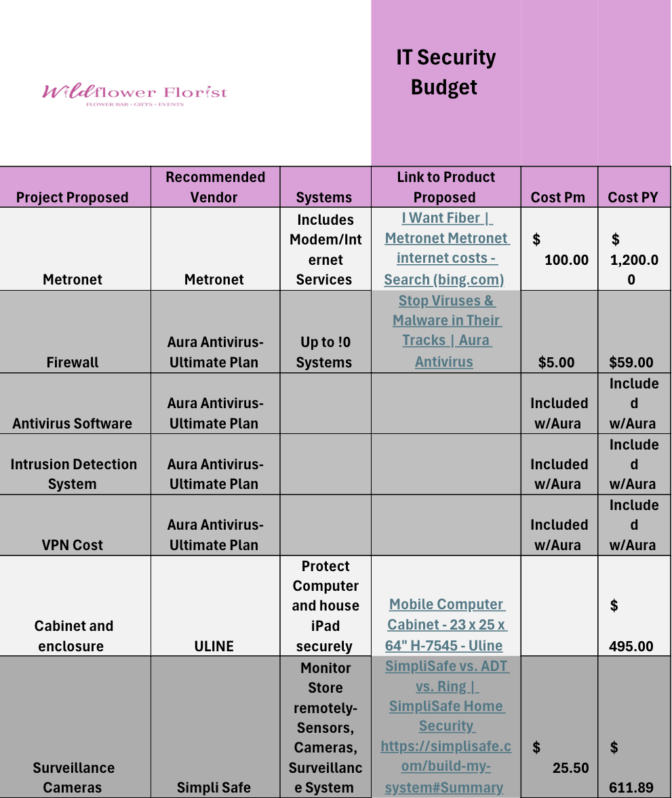
Budget

Slide 17
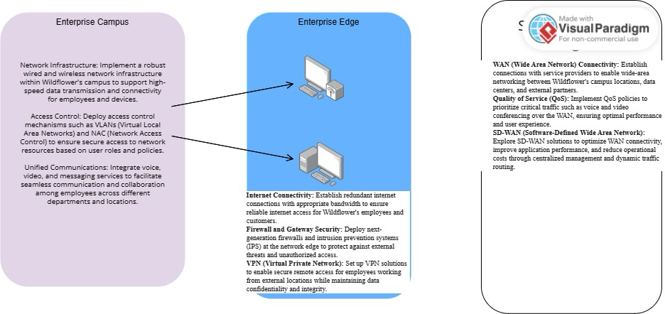
Enterprise Architecture Diagram
Notes:
Go back over our updated diagrams

Slide 18
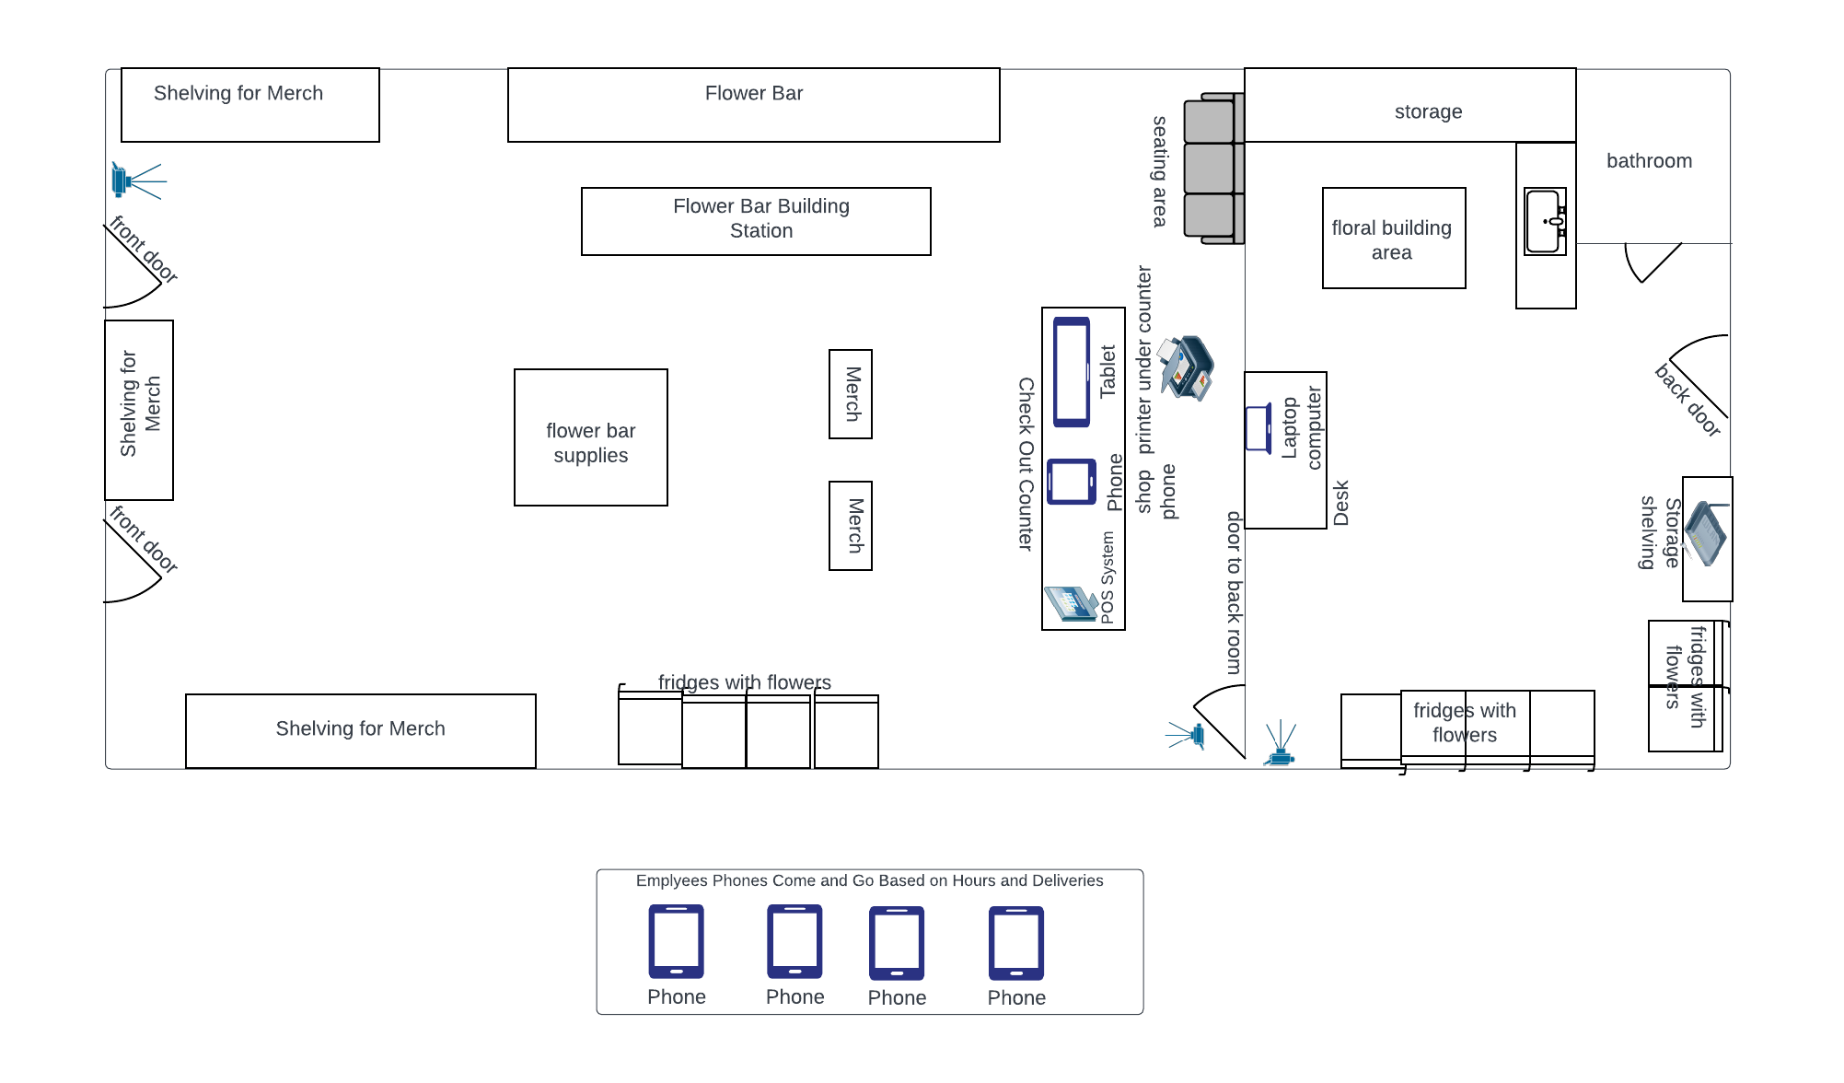
Physical Network Structure

Slide 19
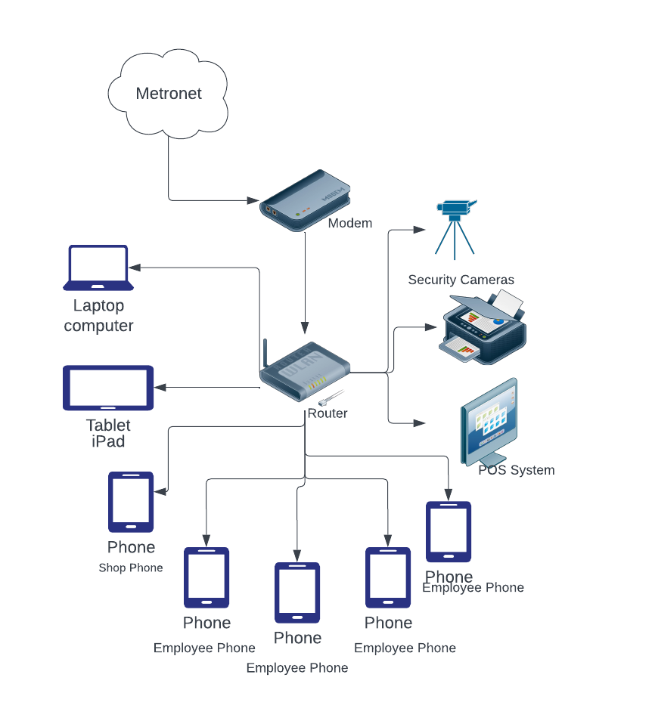
Logical Network Diagram

Slide 20
Conclusion
By following this migration plan, Wildflower Florist LLC can successfully upgrade its IT infrastructure, enhance network security, and ensure minimal disruption to business operations. With careful planning, thorough preparation, and effective execution, the migrating process will position the company for improved efficiency, compliance, and resilience in the ever-evolving digital landscape.

